Slide 1
Electronic Proficiency Testing (ePT) Troubleshooting Guide
RTCQI Best Practice Workshop 2024
Presenter:
Christine Thomas, GLESSN
(in collaboration with Kasantana Jepeton-Hall)

Slide 2
Introduction to ePT
The Electronic Proficiency Testing (ePT) platform, is an online system designed to manage the HIV Dried Tube Specimen (DTS) PT program currently used in Jamaica and Trinidad & Tobago.
The project is supported by the U.S. President's Emergency Plan for AIDS Relief (PEPFAR) through the U.S. Centers for Disease Control and Prevention (CDC).
2

Slide 3
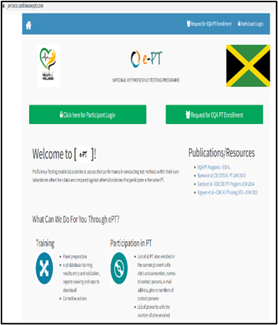
ePT Participant Login Page
3

Slide 4
GLESSN's Role
Global Laboratory and Epidemiology System Strengthening Network (GLESSN):
Collaborates with CDC Caribbean Regional Office.
Partners with Ministries of Health in Jamaica and Trinidad.
Support the Implementation of HIV Rapid Test Continuous Quality Improvement (RTCQI) program in both countries.
Provides consistent high-quality practical training of HIV rapid testers
Trains auditors on the use of the Stepwise Process for Improving the Quality of HIV rapid and Recency Testing (SPI-RRT) checklist.
Supports ePT by hosting and managing the electronic proficiency testing web portal including providing training and troubleshooting for both countries.
4

Slide 5
PT Administrator
The role of the administrator includes:
User Management
System Configuration
PT Survey Management
Result Evaluation and Reporting
1999 - 2010
Development
5
Notes:
The administrator plays a crucial role in managing the ePT system, ensuring its smooth operation, and supporting participants throughout the proficiency testing process.
Each country has a PT administrator that supports the program.
The role of the administrator includes:
User Management: Creating and managing new participant logins.
System Configuration: Adding and managing test kits and configuring DTS test settings.
PT Survey Management: Creating new PT Surveys, Setting up shipments, Enrolling participants in shipments
Result Evaluation and Reporting: Evaluating participant responses, Generating and finalizing reports and making reports available to participants.

Slide 6
Introducing ePT Troubleshooting Guide – Purpose:
Implementing the online platform highlighted challenges common to both countries.
Issues included:
User interface difficulties
Technical glitches
Frequent communication with developers was necessary to resolve these concerns.
The ePT User guide is already available – the Troubleshooting guide is meant to complement and assist.
GLESSN conducted stakeholder consultations to:
Validate and understand common platform issues
Finalise elements of the guide
6

Slide 7
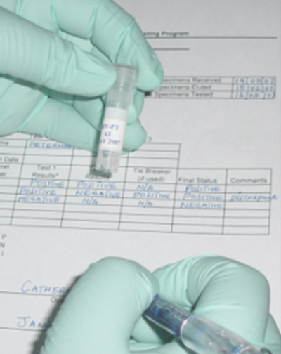
Introducing ePT Troubleshooting Guide – Benefits:
The troubleshooting guide was developed to:
Address frequently asked questions and improve the efficiency of the program.
Empower users to solve common issues independently
Minimize the need for frequent support interventions
Serve as a resource for onboarding new users and improving user satisfaction.
Regular updates are planned based on stakeholder feedback to ensure the platform continues to meet user needs.
7

Slide 8
The ePT Troubleshooting Guide
Key Features:
Step-by-step solutions for common issues
Provides recommendations
Categorized by sections in the “ePT Admin User Guide” and hyperlinked for easy navigation and access to instructions.
8

Slide 9
Common Issue Categories
1. Login Issues
2. Configuration Problems
3. Managing PT Surveys and Shipments
Development
4. Report Generation and Access
1999 - 2010
9

Slide 10
Login Issues
ISSUE: Unable to log in to the ePT platform
CAUSE | SOLUTION
Internet connection problems | Check your internet connection/ Try using a different browser or device
Incorrect URL | Verify correct URL https://jamaica.caribbeanept.com/ or https://trinidad.caribbeanept.com/
Browser cache and cookies | Clear your browser cache and cookies
Server may be offline | Contact Support
10

Slide 11
Login Issues
ISSUE: Participant ID created but unable to login
CAUSE | SOLUTION
Participant login not mapped to participant ID | Admin to map participant login to participant ID (Admin Guide section 1.6)
Incorrect login credentials | Check login credentials; use 'Forgot Password' link to reset password if needed
Incorrect password; password was not saved. | Enable Password Saving after password reset and save password.
11

Slide 12
Login Issues
ISSUE | CAUSE | SOLUTION
Participants not able to log in after changing password. | The password change may not have been successful. | Admin can change the participant's password through the Configure > PT Participants Login menu. or Alternatively, ask the participant to check their spam folder for a password reset link.
Admin can't enter results | System does not allow Admin to enter results. | Create a Data Manager account for admin (Guide 1.1, 1.2)
Admin unable to edit login info for participants. | Incorrect section. | Use "Edit Participant login" section (Guide 1.5)
12

Slide 13
Login Issues
ISSUE | CAUSE | SOLUTION
Participants were entered using the bulk import method, but the IDs could not be located in the system. | The incorrect spreadsheet may have been used. The upload may not have been completed. | To add participant through bulk import, go to the ePT Admin User Guide , section 1.7 Bulk Import Participants. Successful upload of the file is achieved only when the message saying ‘upload successful’ appears on the screen.
13

Slide 14
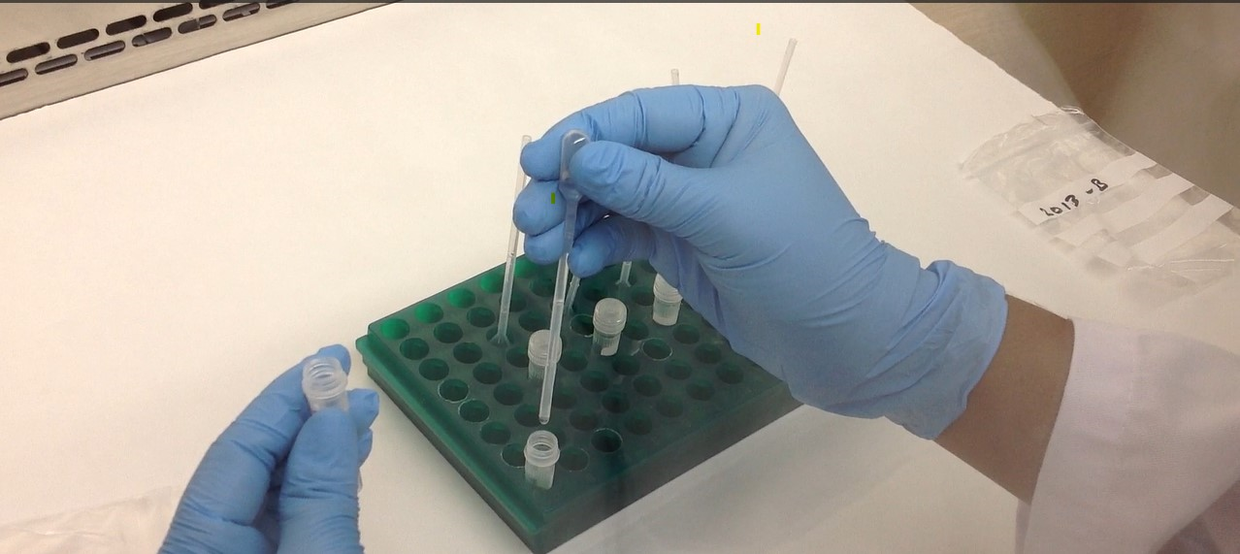
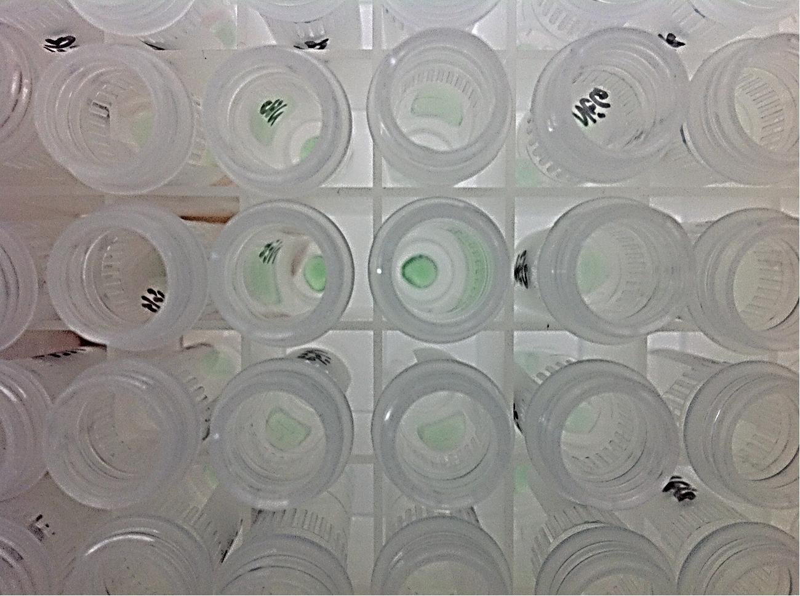
Issue: Test kits not available for selection
Configuration Problems
Cause: Test kits not added to the system
Solution: Admin to add test kits (Admin Guide section 2.4)
Issue: Incorrect DTS HIV Serology score breakups
Cause: DTS HIV Serology settings not properly configured
Solution: Admin to configure DTS HIV Serology settings (Admin Guide section 2.3)
14

Slide 15
Managing PT Surveys and Shipments
Issue: Unable to enroll participants in a shipment
Issue: Current PT Survey not listed
Cause: PT Survey not successfully added to the system.
Cause: Shipment not created or finalized
Solution: Admin to create a new PT Survey (Admin Guide section 3.1)
Solution: Admin to create and finalize shipment (Admin Guide section 3.2)
15

Slide 16
Report Generation and Access
Issue: unable to download report after generation.
Issue: Participant not able to see the entire page.
Issue: Administrator not able to generate and analyse reports.
Issue: unable to download report after generation.
Cause: The page may need resizing.
Cause: The event was incorrectly set up.
Cause: Reports not finalized
Solution: resize or zoom, by Manipulating the minus (-/+) side of the zoom option until the entire page is visible.
Solution: Admin to set up event (Admin Guide section 3.2)
Solution: Admin to finalize report for participants to download (Admin Guide section 3.5)

Slide 17
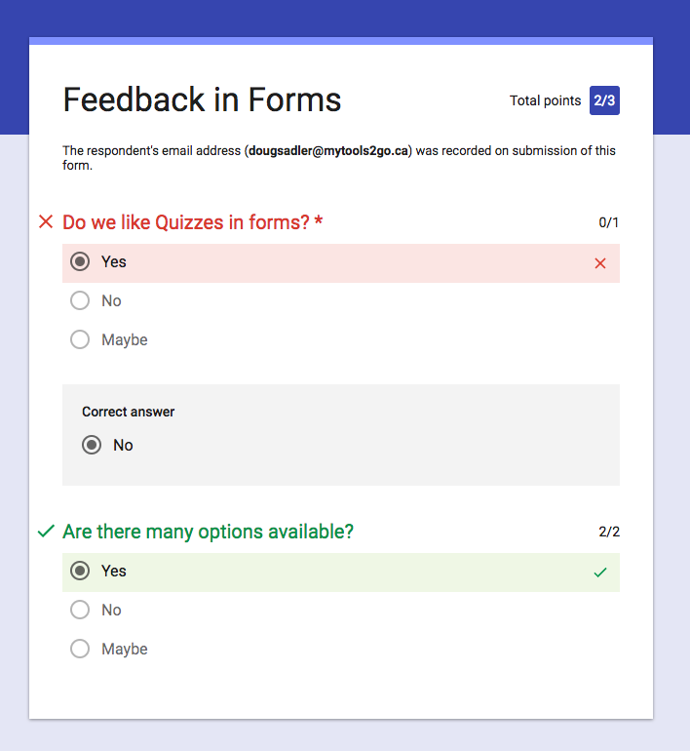
Contacting Support
When to contact support
Contact the GLESSN team If you have followed the troubleshooting steps, and your issue remains unresolved.
Information to provide on Google form when seeking assistance:
A detailed description of the problem.
Steps you have already taken to troubleshoot the issue.
Screenshots or error messages, if applicable.
Device and software version details.
Follow the Link in the Troubleshooting guide to request Assistance.
Phone
Email
Website
+876-620-9564
k.jepeton-hall@glessn.org
www.GLESSN.com
Instagram
Linkedin
17
@glessnconsultants
GLESSN

Slide 18
Thank You.
Sources: ePT Admin User Guide and Troubleshooting Guide
18

